Slide 1

HR-Churn Prediction
Mohit kumar mahato
11913514

Slide 2

Certificate

Slide 3
Introduction
Profile Of the Problem:
Case Study:
There is an ever increase in focus of effective requirement. An organization invest a lot of time and resources in search of potential candidates. The investment become loses is the selected candidate do not join organization in the end.
Challenges:
➢ Recruiter need to understand the chances of candidate of joining the organization.
➢ There are numerous factors for which the candidate can backout of the job.
➢ Confidential data cannot be obtained.

Slide 4
The variables collected were as follows :-
Candidate reference number , DOJ extended , Duration of accept offer , Notice period ,
Offered band , Percentage hike Expected , Percentage hike offered , Percentage Difference ,
Joining Bonus , Gender , Candidate source , Year of experience , LOB ,
DOB , Joining location , Candidate relocation status , HR status.

Slide 5
Technologies Learnt
Python:
Python is an interpreted, object-oriented, high-level programming language with dynamic semantics. Its high-level built-in data structures, combined with dynamic typing and dynamic binding, make it very attractive for Rapid Application Development, as well as for use as a scripting or glue language to connect existing components together.
Data Wrangling:
Data disputes include processing data in a variety of ways such as merging, grouping, merging etc. for the purpose of analysis or to make them ready for use with another set of data. Python has built-in features to use these conflicting methods across various data sets to achieve analytical purpose.

Slide 6
Descriptive Statistics:
Descriptive statistics are short descriptive coefficients that summarize a set of data provided, either for public representation or a sample of people. Descriptive statistics were divided into measures of inclination and variance measures (spreads). Moderate inclination methods include mean, medium, and mode, while variability measures include standard deviation, variability, quantity and maximum variability, kurtosis, and skewness.
Machine Learning:
Machine learning (ML) is a type of artificial intelligence (AI) that allows software applications to become more accurate at predicting outcomes without being explicitly programmed to do so. Machine learning algorithms use historical data as input to predict new output values.

Slide 7
Software required
Python
NumPy Package Python
Pandas Package Python
Matplotlib Package Python
Seaborn: statistical data visualization Python Package
Scikit-learn ( sklearn) python Machine Learning Package
Random forest classifier

Slide 8
Problem analysis
We are provided Datasheet which consists data of 8998 candidates which includes :-
Candidate reference Number , Date of Joining extension , Duration of accept the offer , Notice Period , Offered band , Percentage hike expected , Percentage hike offered , Percentage difference , Joining bonus , Gender , Candidate source , Year of Experience , Line of Business , Cate of Birth , Joining Location , Candidate Relocation status , and HR status
We have to train the Machine learning model using this data so that it can predict the chances of upcoming candidates “HR status” whether they will be joining the organization or not .
So basically, we have to use Supervised learning where our model will be trained using the data sheet Input variables except HR status and output variable HR status which is Final joining status of the candidate.
Here Independent variables are all the variables except HR status and dependent Variable is HR status which depends on the other factors

Slide 9
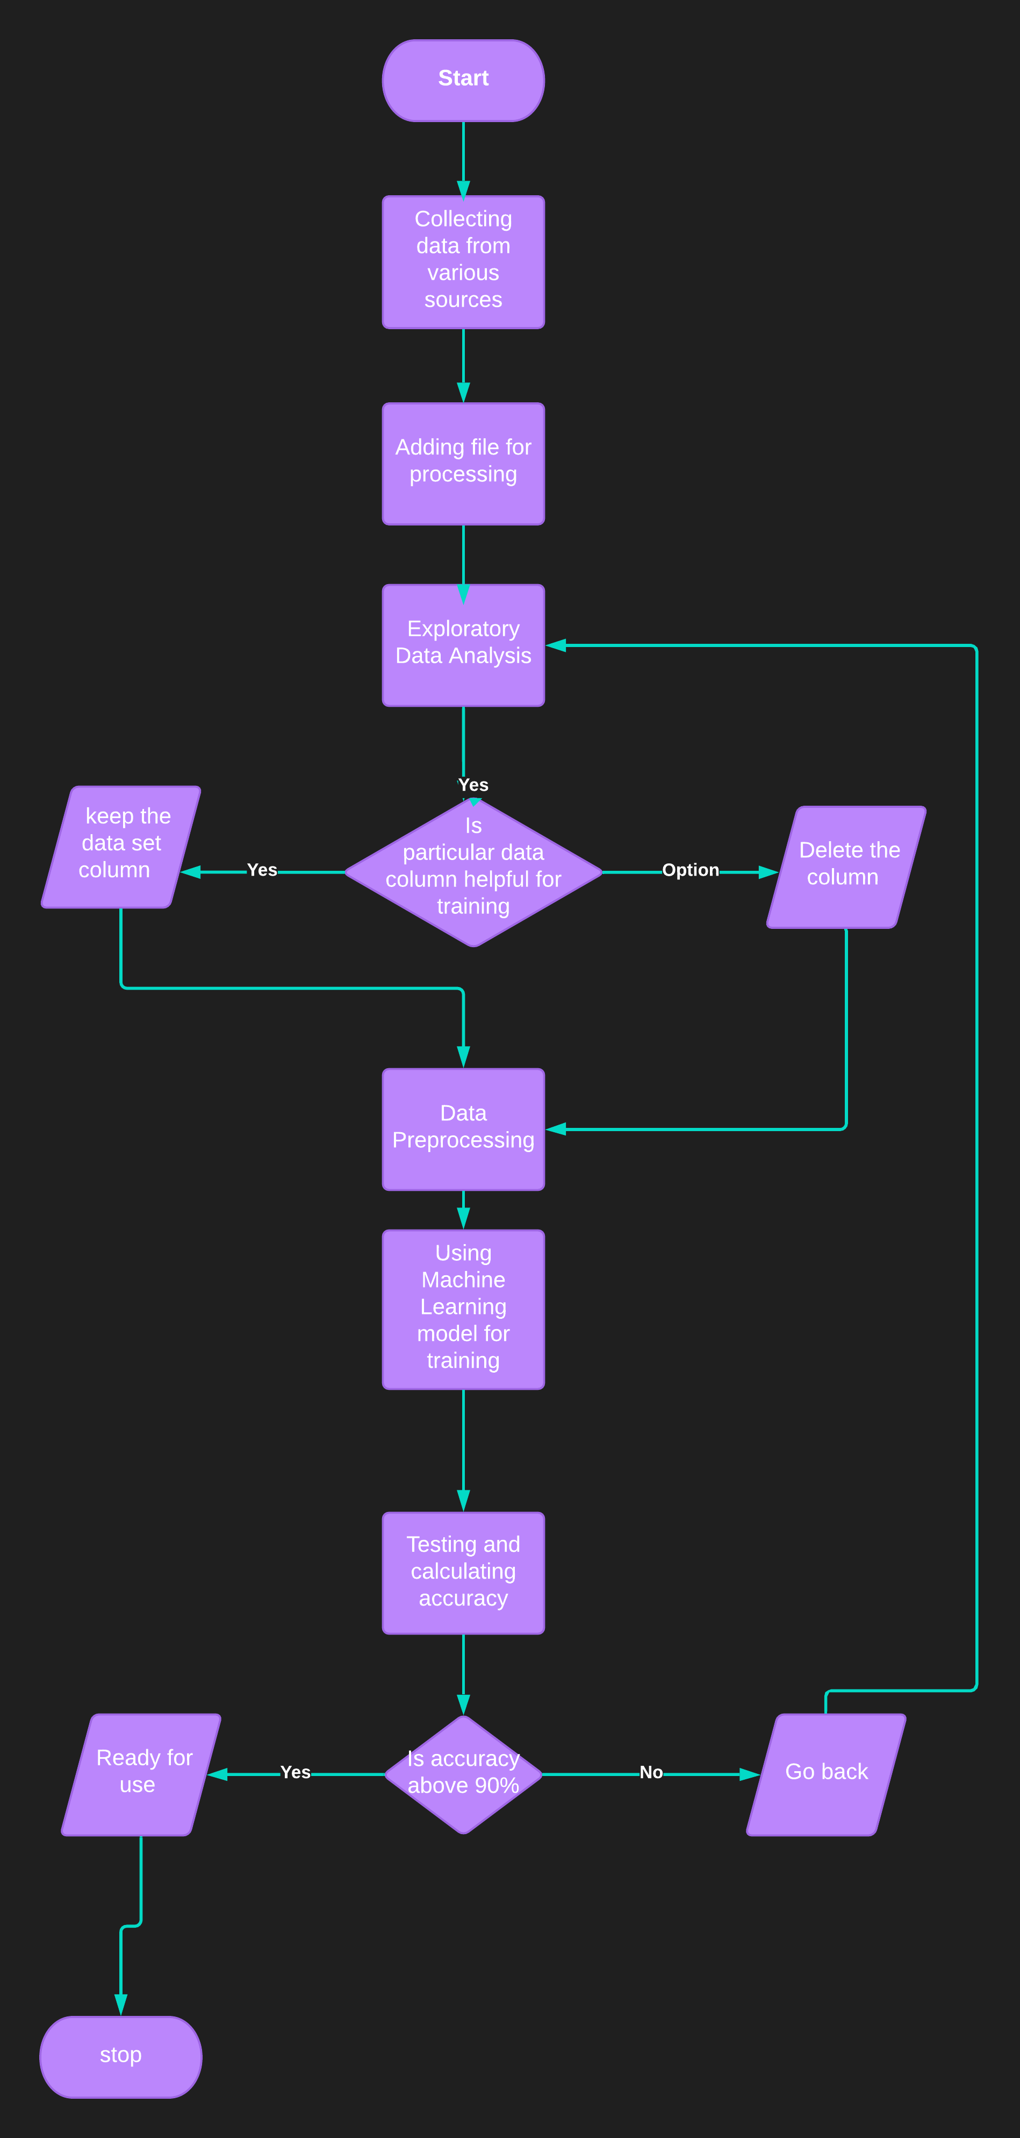
Flow chart

Slide 10
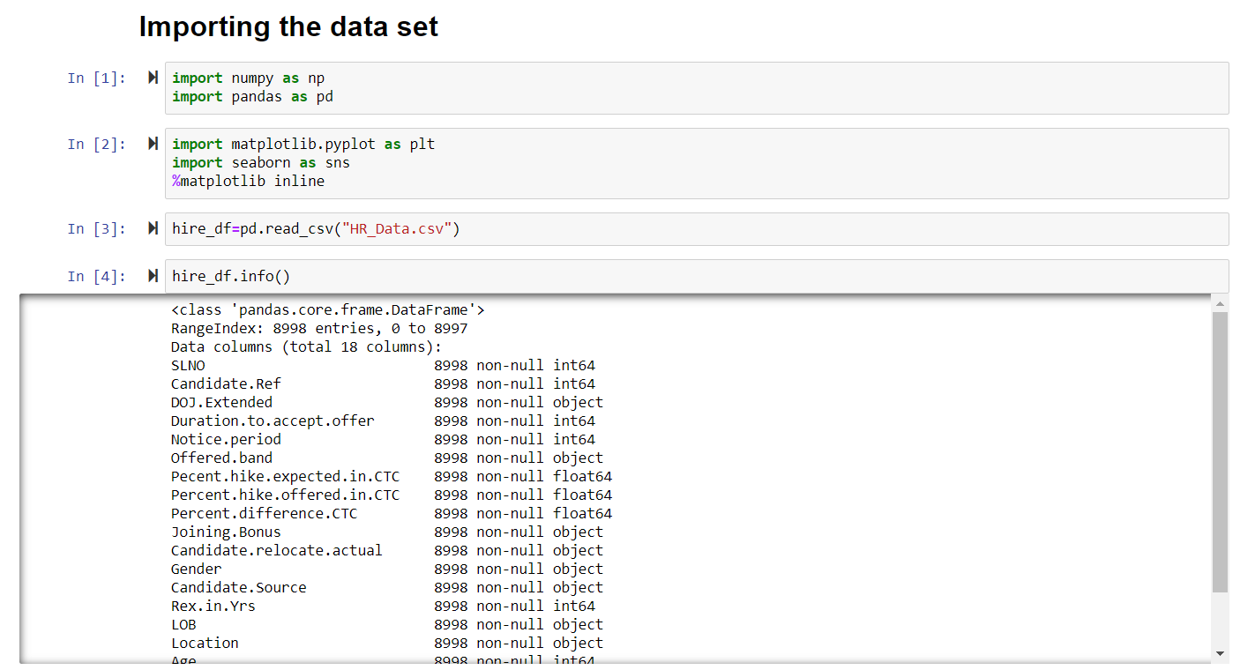
Implementation

Slide 11
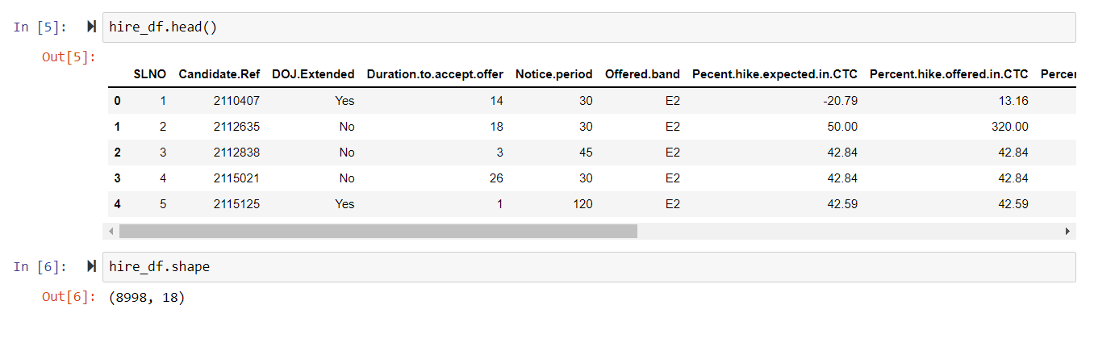
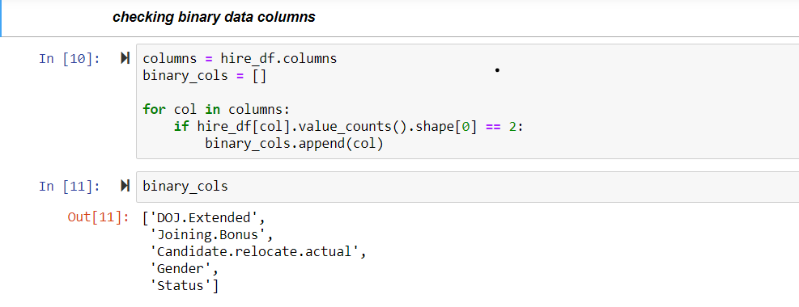

Slide 12

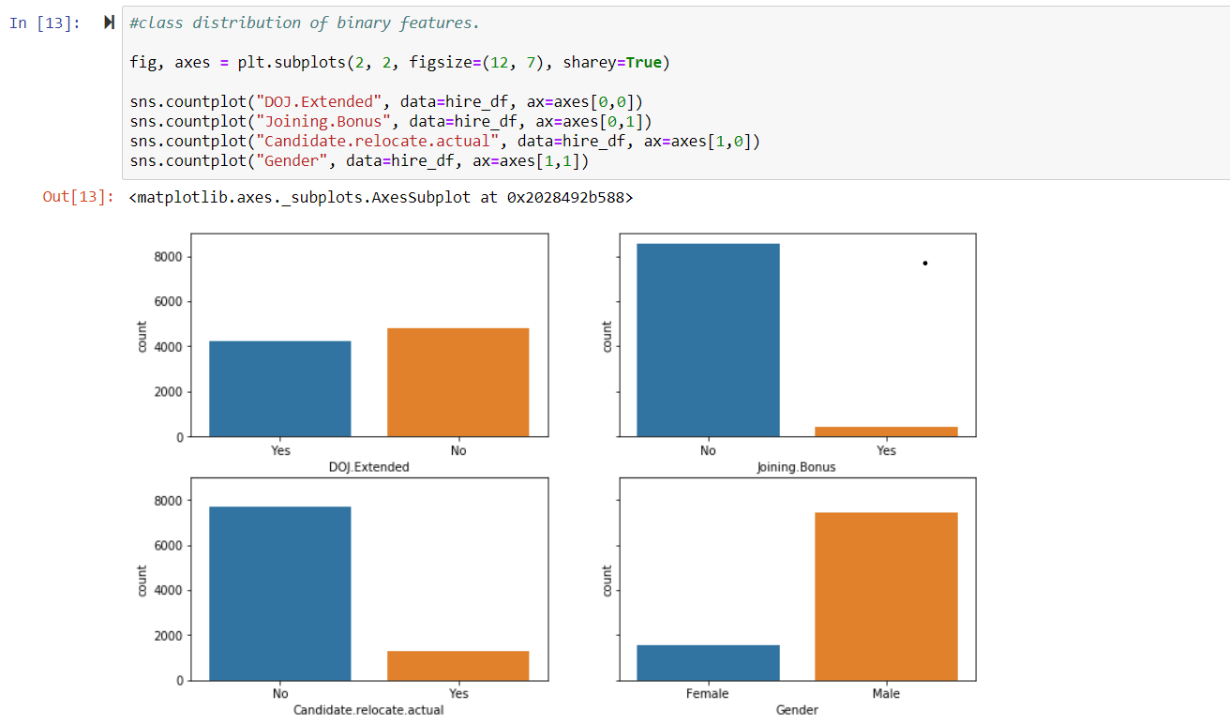

Slide 13
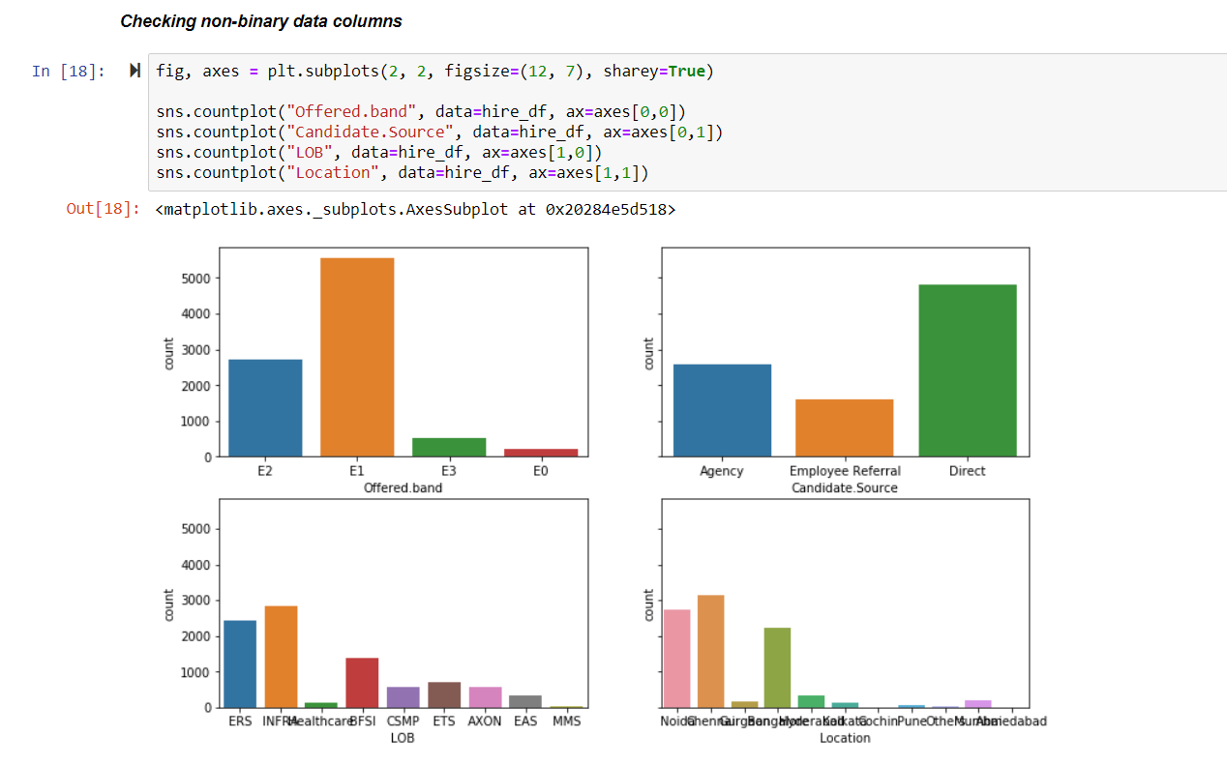

Slide 14
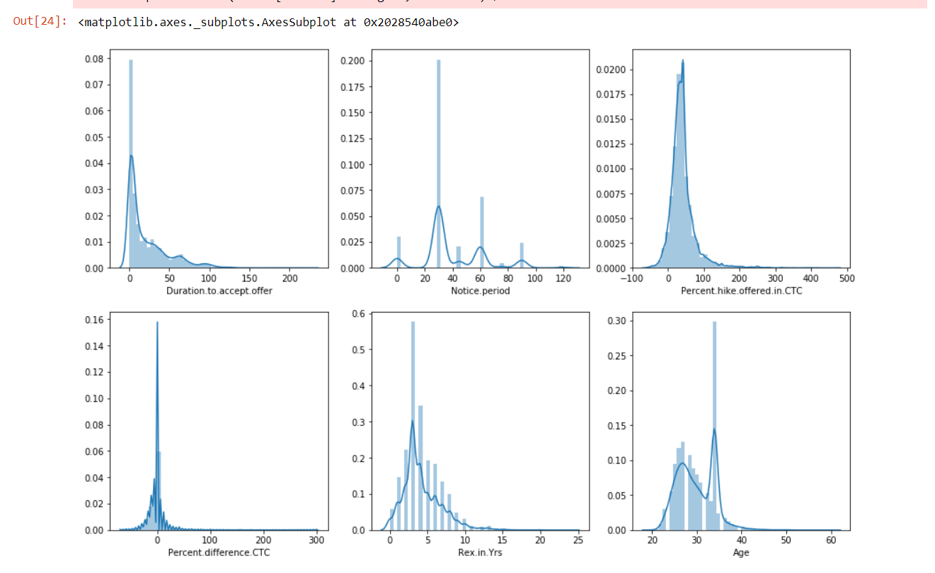

Slide 15
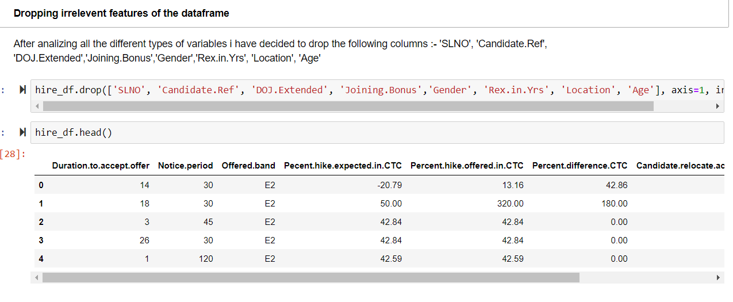
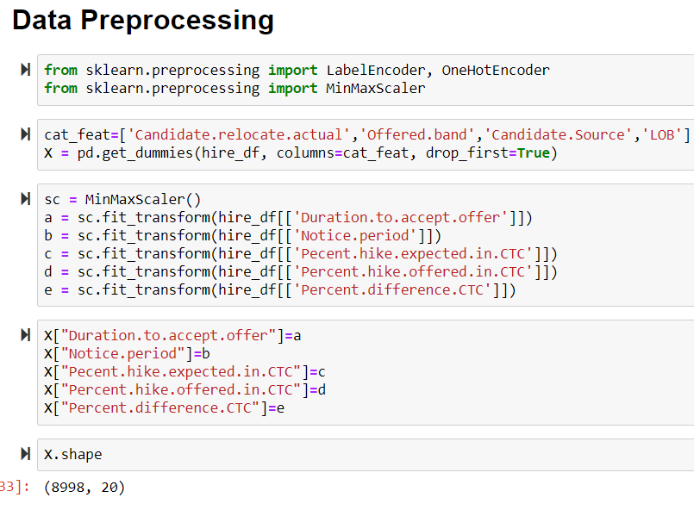

Slide 16
